Slide 1
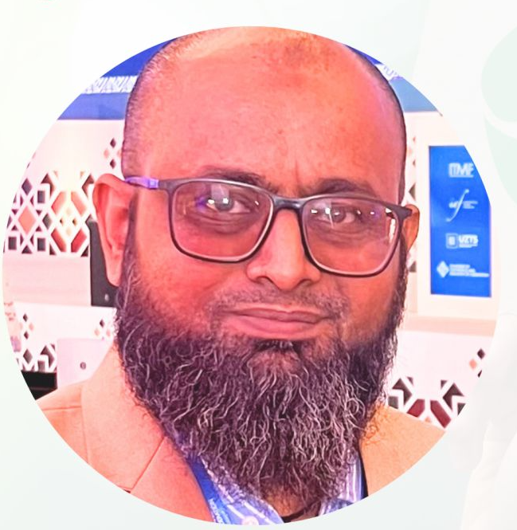
Introduction
Imran Asghar
Head of Asia - Pacific FibreTrace
Fashion Advisory Board Member
Material Exchange
Founder Sourcery Group
Member at Textile Exchange
Organic Cotton Standard Revision 3.0
Alpaca Standard, Animal Fibre Standard
MMCF & Home & Hospitality Working group
Proprietary & Confidential.
September 10th 2025. Global Textile Days 2025_Tashkent

Slide 2

Meet FibreTrace®
FIBRETRACE
A genuine, real-time verification solution for fibre integrity.
In an era of heightened environmental consciousness, FibreTrace® aims to empower every member of the global textile supply chain to make better decisions for the environment and their community.
We connect physical and digital technology to provide unparalleled results.

Slide 3
Increasing regulatory and investment pressure means you must ensure the fibre in your end product, is indeed what you are selling (and reporting) it to be.
4

Slide 4
We are today uniquely positioned as a control, providing the security and credibility necessary to empower accelerated responsible sourcing and circularity initiatives + add enhanced integrity to digital traceability.
Proprietary & Confidential.
March 2025.

Slide 5
COMMERCIAL CONSIDERATIONS
1
2
RISK
DATA
Value & Benefits
DPP – Visibility of product with full traceability, primary and secondary data from raw fibre to store and beyond to recycle.
EU Law – Physical Fibre verification; Digital verification; Intergration of any PLM, ERP, Supply Monitors, End of Life and ESG software systems.
UFLPA– Physical Digital fibre verification of origin, for irrefutable proof, from Raw Fibre to Shelf and beyond to customer.
De-risking your supply chain. Allowing suppliers and brands to detect fibre dilution or substitution in real time. Empowering supply chains to protect at risk, core and high value fibres at each point of the supply chain.
Primary Data FibreTrace technology and real time scanning allows you to save real time primary data, along with secondary data such as document uploads, to strengthen and validate at all data points within the supply chain.
3
4
INNOVATION
MARKETING
FibreTrace promotes and priorities intergration and harmonisation. Encouraging collaboration, research and development initiatives for the best possible solutions.
Guarantee of fibre authenticity allows brands and supply chains the ability to promote and market without risk of fraud.

Slide 6
DEVELOPMENT INSIGHT
Digital Traceability
In Scoping : EWR Inc, Textile Genesis, ReTraced, Open Supply Hub, TrusTrace
Under Liaison : Cotton Connect
PLM
Product lifecycle management software.
Active : via Zapier.
Flexible Integrations
FibreTrace® value industry collaboration.
We provide ﬂexibility by integrating our physical technology, and fibre verification data with ANY digital system.
We aggregate information collected across the supply chain, in real-time, to support importation legislation and business insights.
We increase the value and credibility of digital traceability.
You own your data. We aim to de-risk technology stack investments through interoperability.
ERP
Integrated business management software.
Active : via Zapier.
Supply Monitors
Compliance, Certification, monitoring and measurement providers.
Current : Manual upload with audits. Future: Partnerships under liaison.
End of Life
Post consumer tracking technology and software.
Future State.
ESG
Impact data software solutions and agri tech that supports the monitoring of environmental data.
Future State.

Slide 7
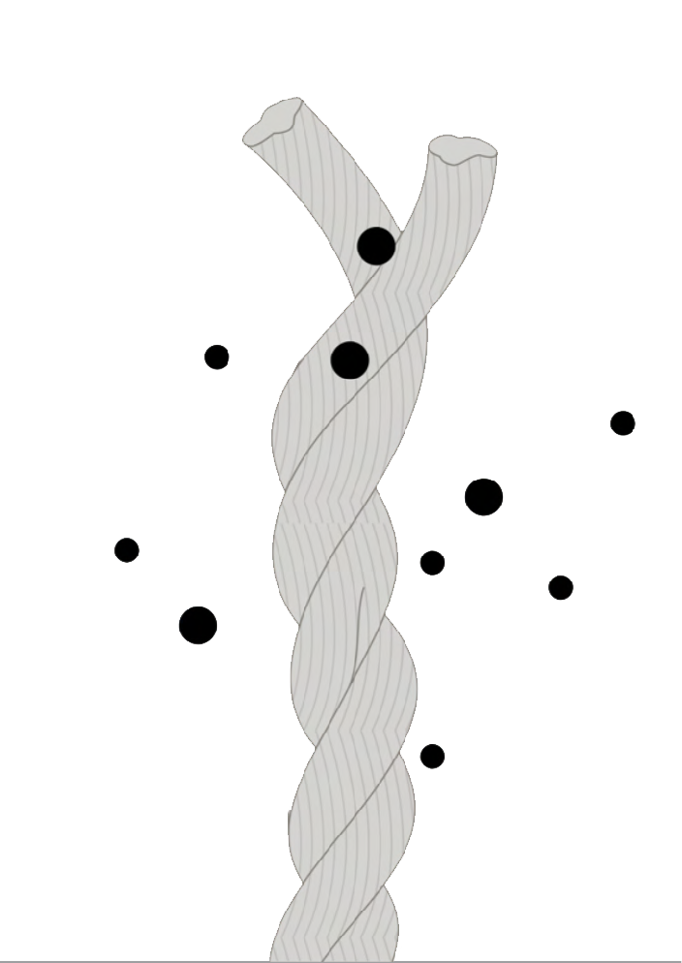
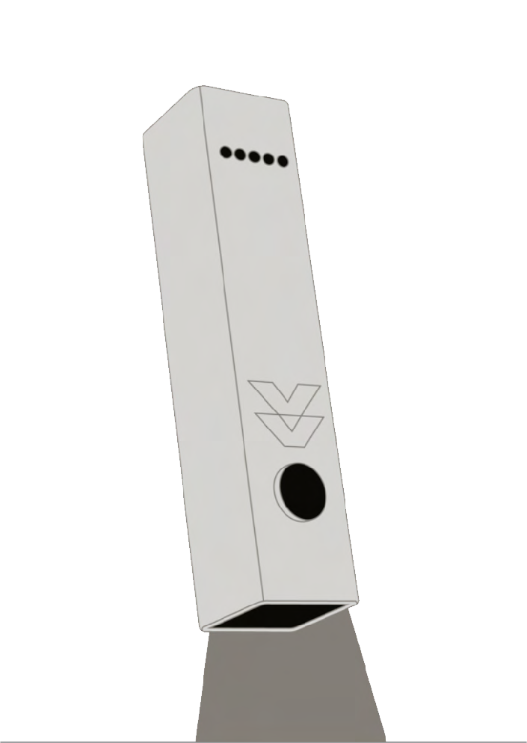
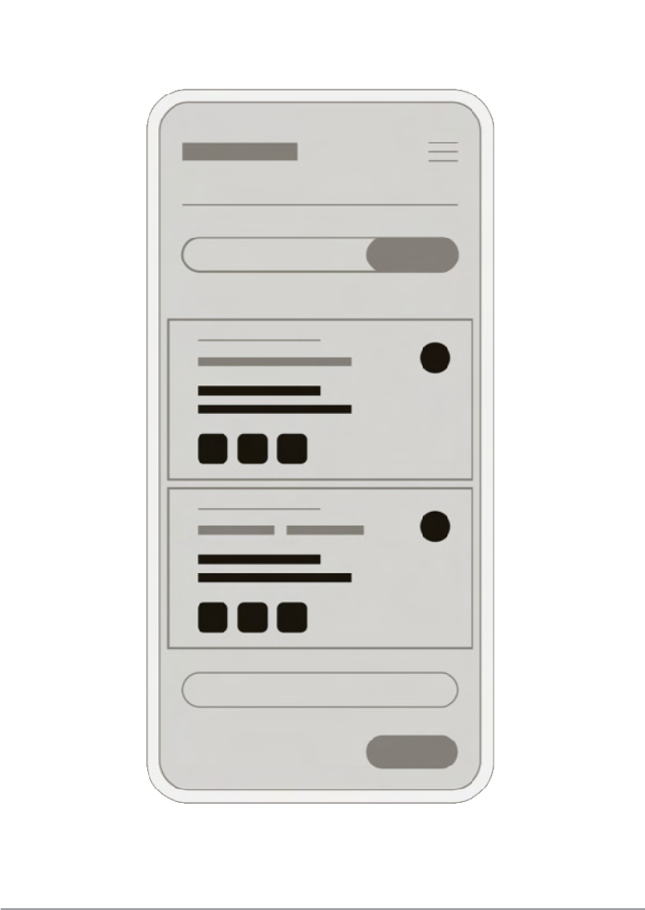
Pigment ID
FIBRETRACE
01
Scanner
02
Digital Output
03
Our 3-step Solution Is...
Our inorganic pigment is embedded into textile products from raw fibre, identifying your fibre for life (inc. reuse & recycle).
Suppliers use our scanners to identify and record FibreTrace-activated fibres in real-time, and at every tier in your supply chain.
Recorded data is logged to our blockchain platform, (or platform of choice) to seamlessly handle all traceability measures.

Slide 8
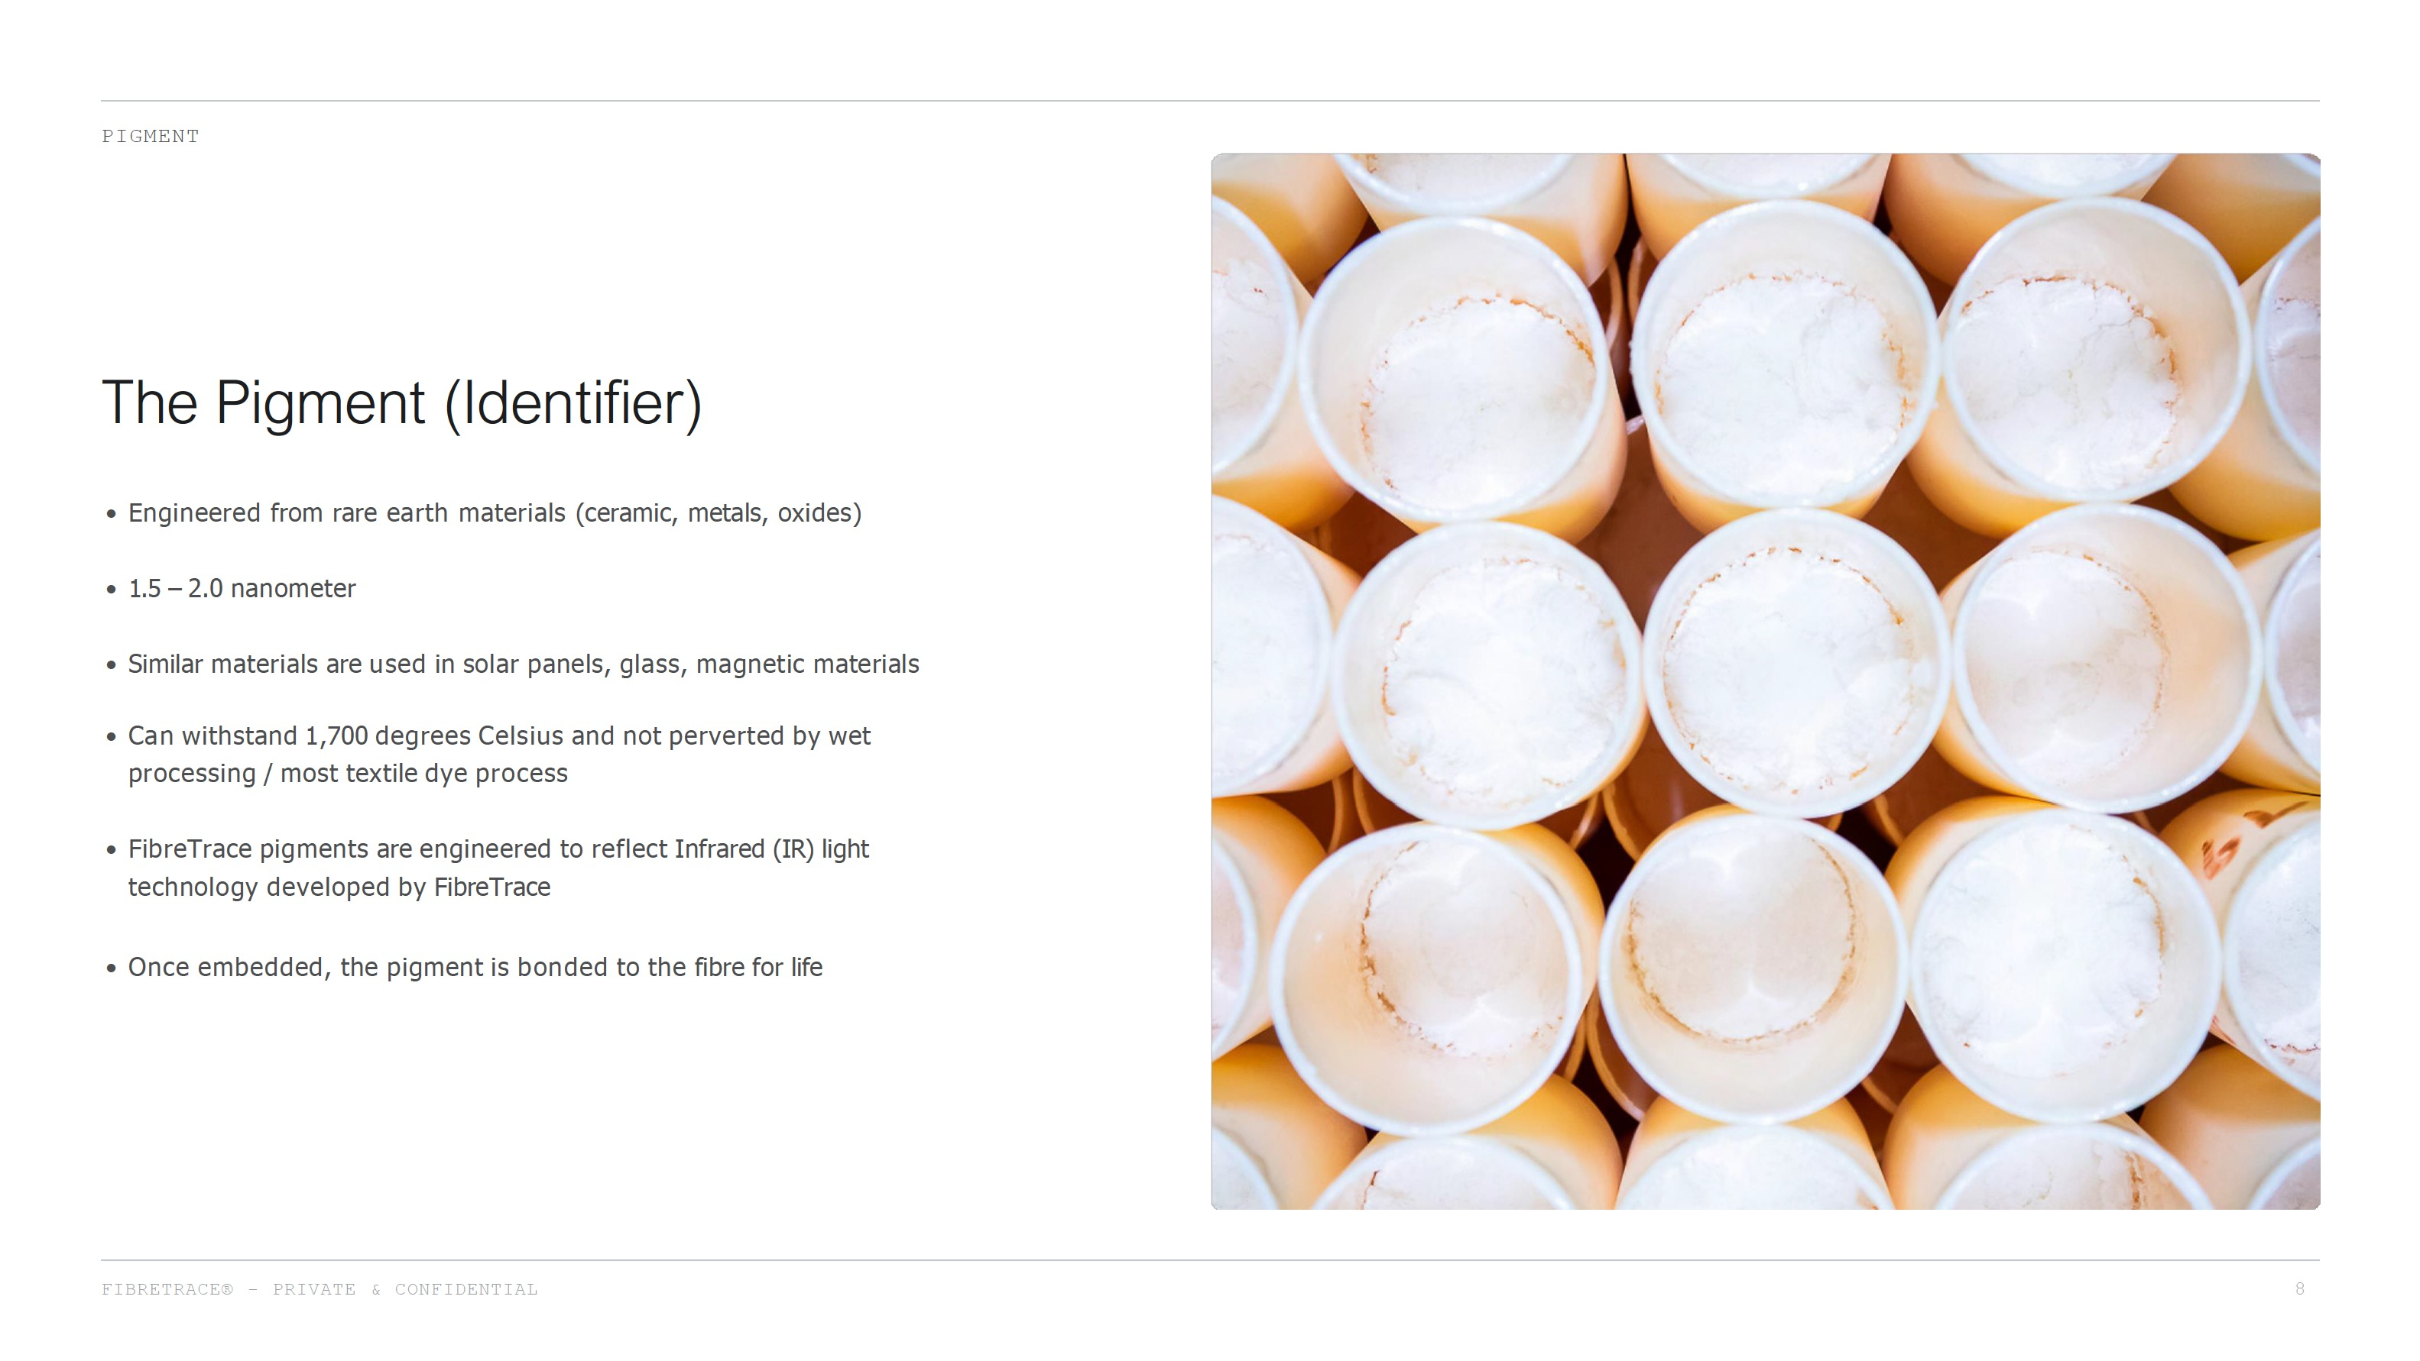

Slide 9
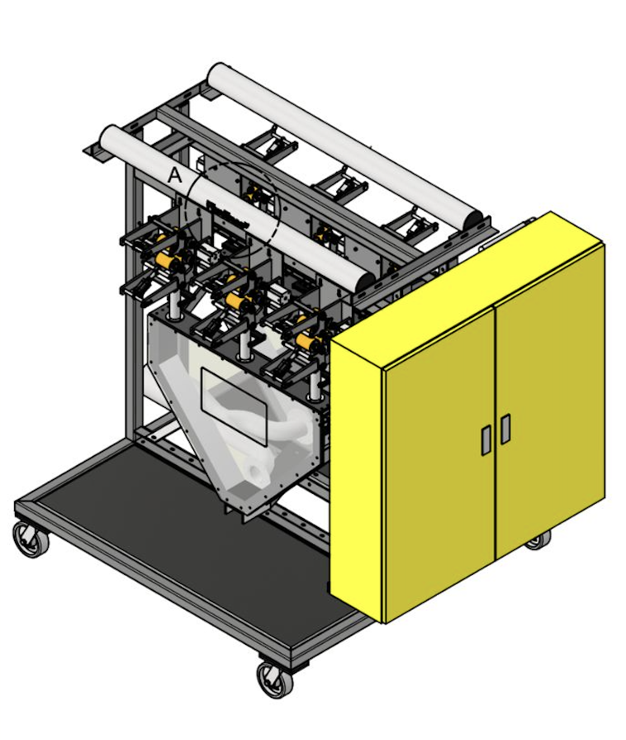
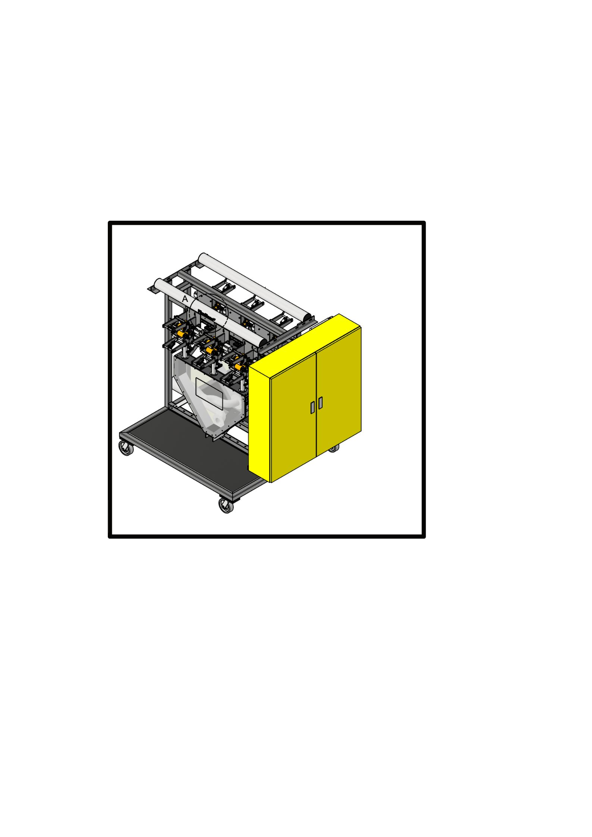


Natural Fibre Application
FIBRETRACE
Pigment Application
FT pigments and made into a slurry/sliver, and applied to natural fibre during raw materials processing stage (ginning or scouring). FT bonds with with natural fibre; physically indistinguishable and indestructible.
Man Made Fibre Application
FT luminescent pigment is produced in liquid form, combined with selected synthetic slurry, and turned into master batch (pellets or chips). Master batch extruded and turned into yarn and fabric.

Slide 10
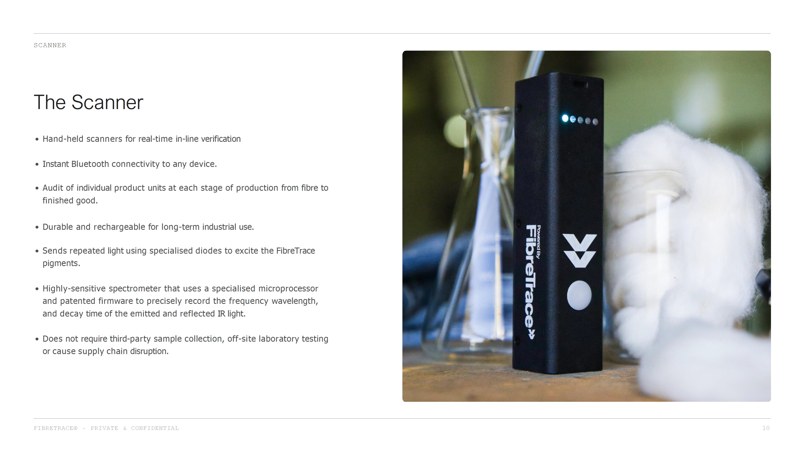

Slide 11
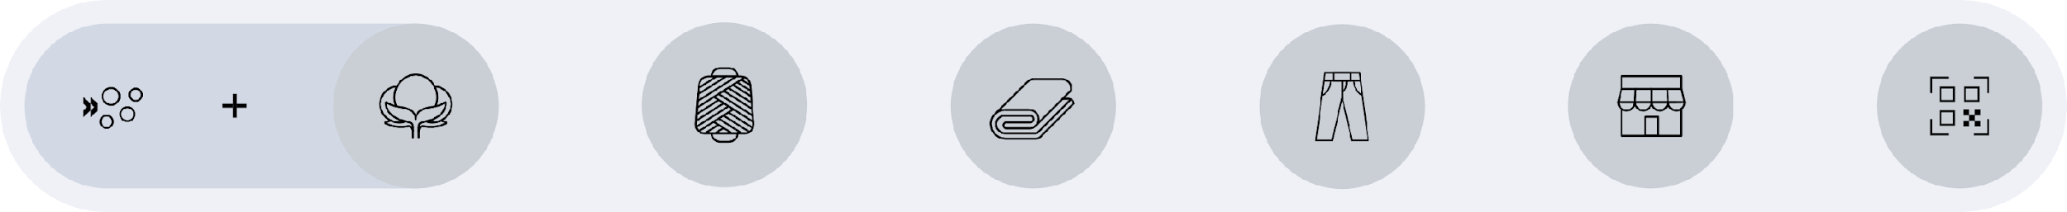

Track your materials at every stage.
FIBRETRACE
FT PIGMENT
+
FIBRE
SPINNER
FABRIC MILL
ASSEMBLY / CMT
BRAND
CONSUMER
DATA UPLOAD
DATA UPLOAD
DATA UPLOAD
DATA UPLOAD
DATA UPLOAD
Notes:
Yellow Box change using Canva

Slide 12
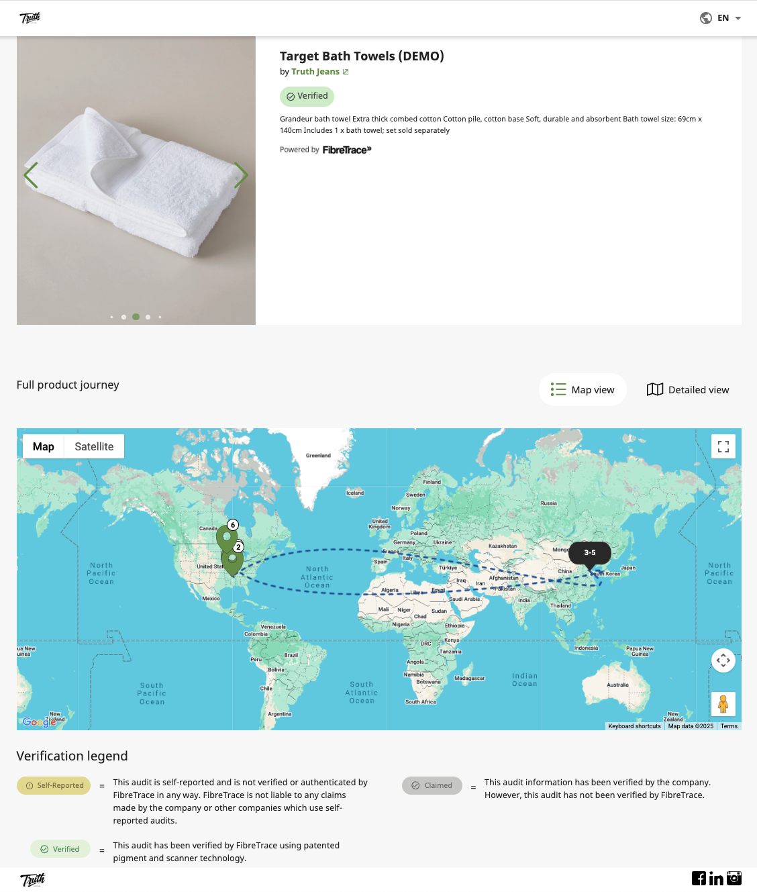
Real-Time Data
FIBRETRACE
Digital Output
Scanner ID – Device identifier
Location – GPS coordinates
Auditor – Person performing the scan
Timestamp – Date and time of scan
Result – Pass/fail detection
Signal Strength – Intensity of FibreTrace pigment
Verification – FibreTrace ID validation
Batch Number – Product batch or bale ID
Stage – Manufacturing process stage
Facility – Company/site scanned
Multi-ID – Multiple signature detection
Photos – Optional product images
Audit Data – Additional template responses
Notes:
Need to remove digital output only report Real time data only

Slide 13

FIBRETRACE
Cotton + rCot
(Organic, BCI, GEC, Conventional)
Good Earth (Sundown Pastoral) USA and BZ (Cargill), India (Delight Group), Pakistan (Jatlee Corp.), rCot Turkey (Haksa Tekstil).
Polyester + rPet
(virgin, rPET, biodegradable and T2T)
Lucky Core Pakistan, AmberCylce USA.
Additional partners avail under NDA.
Acrylic
(virgin and recycled)
AKSA, Turkey + Regel by Thai Acrylic Fibres
Fibre and
Material Types
FibreTrace® works with a majority of preferred fibres and materials. We aim to release a new fibre category every year.
High Perf. Polymers
(virgin and recycled)
Radici Group, Italy.
Viscose
(responsible)
EcoCell by KaraFibre, Turkey.
Additional partners avail under NDA.
Wool
(Australian Merino, virgin)
Michelle Wool, Xinao.
Leather¹
Natural Rubber¹
Bast Fibres¹
(Hemp/Linen)

Slide 14

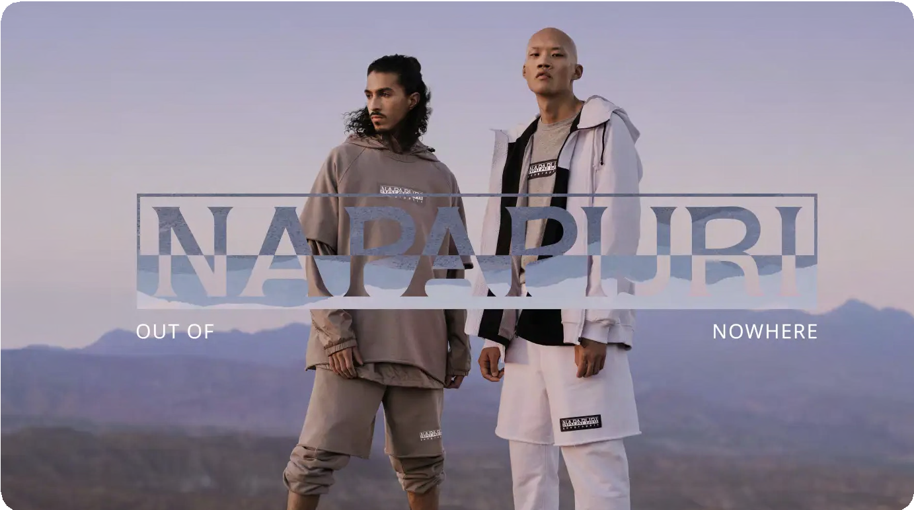
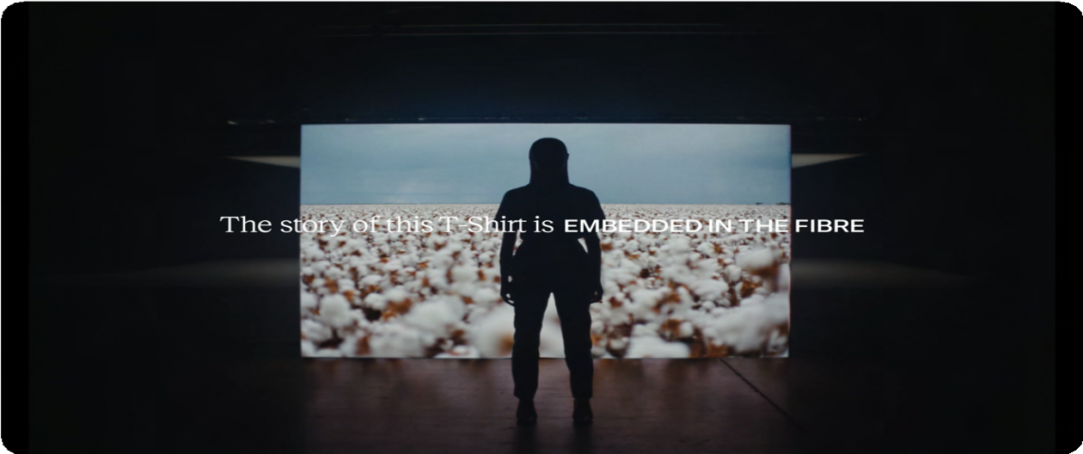










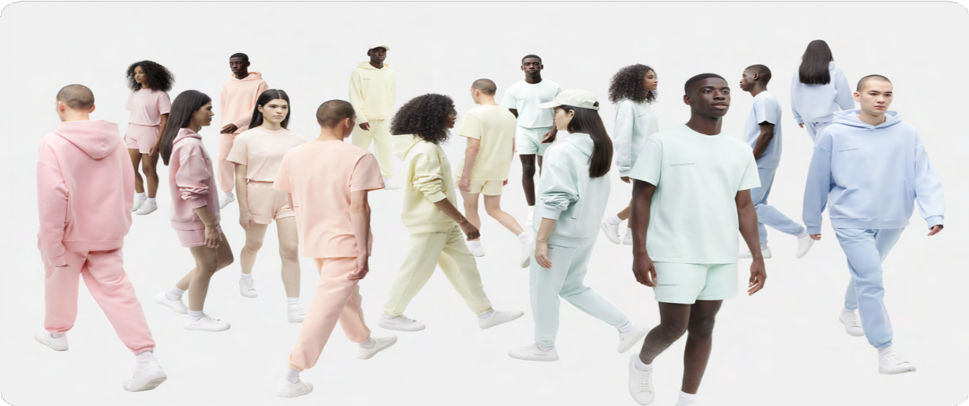








Brand Partners
PARTNERS
Having only been in market 5 years, we are excited to have over 40 brand partners and will continue to see products released to market from september this year.
Launched March 2021 Extended to over 30 styles today
Launching campaign May - July 2024
Launched March 2021, Extended to over 30 styles today
15CoreRTWstylesformenandwomenbackedbyFibreTrace®
Coming late 2024
Launched June 2024.
Secured for two concurrent seasons
Marking 50,000 MT of USA / Brazilian cotton
Notes:
Roddn GUN Baker and Max Fashion

Slide 15
Thank you
Imran Asghar
Head of Asia - Pacific
Imran.Asghar@fibretrace.io
+92 (0) 321 2665 047 (Karachi Pakistan)

Slide 16
Please Contact: Imran Asghar
Imran.Asghar@fibretrace.io M: +92 321 2665 047

